Slide 1


Click here to play

Slide 2
TRUE OR FALSE
WHAT IF…
MORE OR LESS
Question 1
Question 1
Question 1
Question 2
Question 2
Question 2
Question 3
Question 3
Question 3

Slide 3
True or False Question 1
Drinking acidic drinks, like orange juice, WILL damage your teeth
TRUE
FALSE

Slide 4
T/F #1 Answer TRUE
That’s correct!
Drinking an acidic drink, such as orange juice, can eat away the top layer of your teeth (also known as enamel)! Take the safe road and drink water.

Slide 5
T/F #1 Answer FALSE
Incorrect!
Drinking an acidic drink, such as orange juice, can eat away the top layer of your teeth (also known as enamel)! Take the safe road and drink water.

Slide 6
True or False Question 2
Sports drinks are great for all types of physical activity
TRUE
FALSE

Slide 7
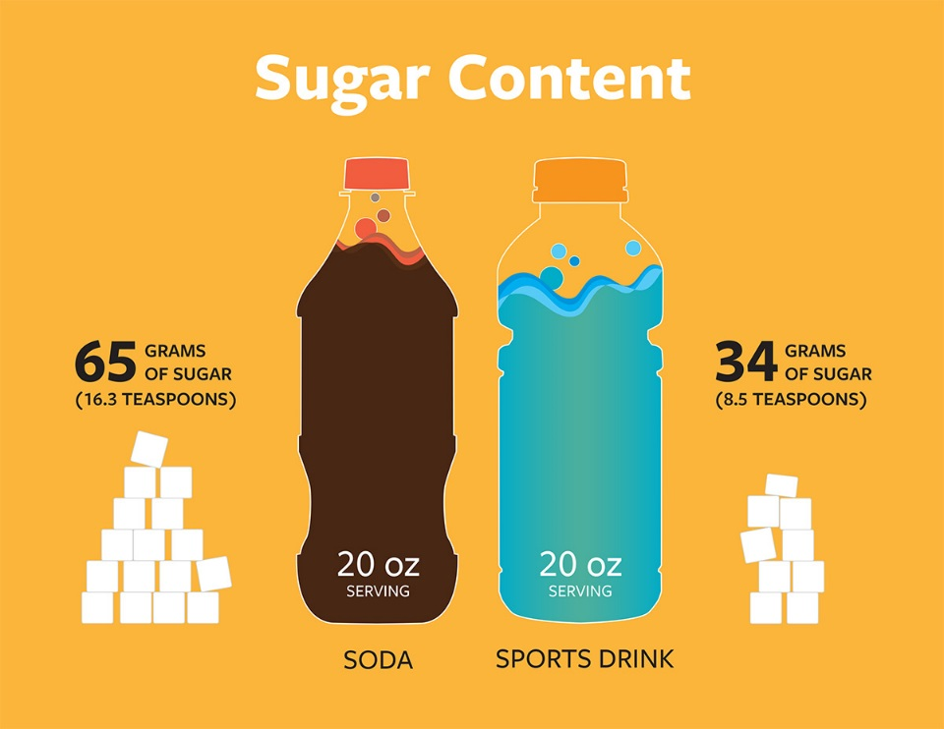
T/F #2 Answer FALSE
That’s correct!
Sports drinks have no nutritional benefits for athletes of lower intensity sports. Sports drinks are only suitable if you’re taking part in more than 90 minutes of activity.
https://uichildrens.org/health-library/sugar-sports-drinks

Slide 8

T/F #2 Answer TRUE
Incorrect!
Sports drinks have no nutritional benefits for athletes of lower intensity sports. Sports drinks are only suitable if you’re taking part in more than 90 minutes of activity.
https://uichildrens.org/health-library/sugar-sports-drinks

Slide 9
True or False Question 3
On average, an American consumes less than 25 gallons of soda pop per year
TRUE
FALSE

Slide 10
T/F #3 Answer FALSE
That’s correct!
An American actually consumes 53 gallons of soda pop per year.

Slide 11
T/F #3 Answer TRUE
Incorrect!
An American actually consumes 53 gallons of soda pop per year.

Slide 12
What if Question 1
What if… your teeth sit in soda pop for 5 days?
Nothing happens
They
rot

Slide 13
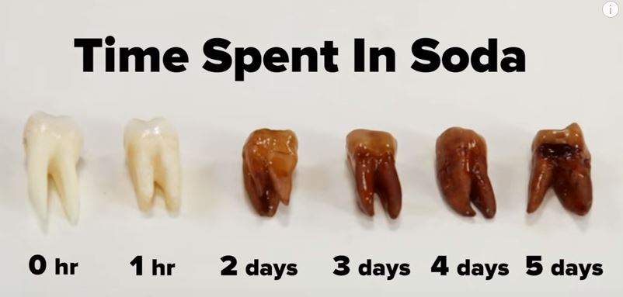
WI #1 Answer THEY ROT
That’s correct!
This is what your teeth look like if they sit in soda pop over 5 days.
https://localtvwjw.files.wordpress.com/2015/11/teeth.jpg

Slide 14
WI #1 Answer NOTHING HAPPENS
Incorrect!
This is what your teeth look like if they sit in soda pop over 5 days.
https://localtvwjw.files.wordpress.com/2015/11/teeth.jpg

Slide 15
What if Question 2
What happens to your body if you drink 8 glasses of water a day?
Happy & healthy
Sick &
tired

Slide 16
WI #2 Answer HAPPY AND HEALTHY
That’s correct!
Drinking water helps keep your mind focused, improves your energy levels and boosts your metabolism which can help with weight loss.
https://localtvwjw.files.wordpress.com/2015/11/teeth.jpg

Slide 17
WI #1 Answer SICK AND TIRED
Incorrect!
Drinking water helps keep your mind focused, improves your energy levels and boosts your metabolism which can help with weight loss.

Slide 18
What if Question 3
If you drink soda pop, you will be…?
Full of energy
Full of
regret

Slide 19
WI #3 Answer FULL OF REGRET
That’s correct!
Drinking soda pop can actually reduce your energy, contribute to weight gain and can harm your oral health. Rethink your drink! Choose water!
https://localtvwjw.files.wordpress.com/2015/11/teeth.jpg

Slide 20
WI #3 Answer FULL OF ENERGY
Incorrect!
Drinking soda pop can actually reduce your energy, contribute to weight gain and can harm your oral health. Rethink your drink! Choose water!

Slide 21
ML Question 1
Which drink has more sugar? Chocolate milk or soda pop?
chocolate
milk
soda pop

Slide 22
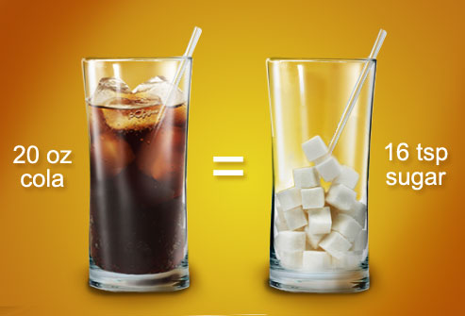
ML #soda pop
That’s correct!
soda pop = 16 teaspoons
chocolate milk = 5 teaspoons
It’s okay to drink chocolate milk sometimes, but don’t forget it does have added sugar.
http://www.ktcwellness.com/blog/2015/2/20/is-soda-really-that-bad

Slide 23
ML #1 Answer MILK
Incorrect!
soda pop = 16 teaspoons
chocolate milk = 5 teaspoons
It’s okay to drink chocolate milk sometimes, but don’t forget it does have added sugar.
http://www.ktcwellness.com/blog/2015/2/20/is-soda-really-that-bad

Slide 24


ML Question 2
Which drink has more sugar? Sports drink or energy drink?
sports drink
energy drink

Slide 25
ML #2 Answer SPORTS DRINK
That’s correct!
sports drink = 14 teaspoons
energy drink = 10 teaspoons

Slide 26
ML #2 Answer ENERGY DRINK
Incorrect!
sports drink = 14 teaspoons
energy drink = 10 teaspoons

Slide 27
ML Question 3
Which drink has the least amount of sugar, orange juice or water?
orange juice
water

Slide 28
ML #3 Answer WATER
That’s correct!
water = 0 teaspoons
orange juice = 11 teaspoons
Water is the healthiest choice! Rethink your drink!

Slide 29
ML #3 Answer ORANGE JUICE
Incorrect!
water = 0 teaspoons
orange juice = 11 teaspoons
Water is the healthiest choice! Rethink your drink!

Slide 30

Thanks for playing!

